Slide 1
Logistic Regression

Slide 2
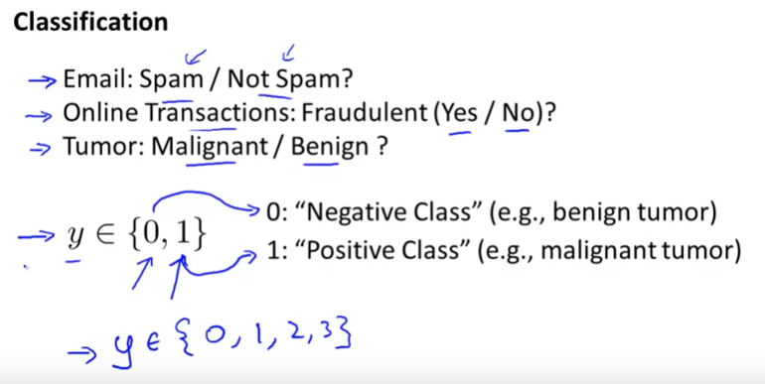
Logistic Regression

Slide 3
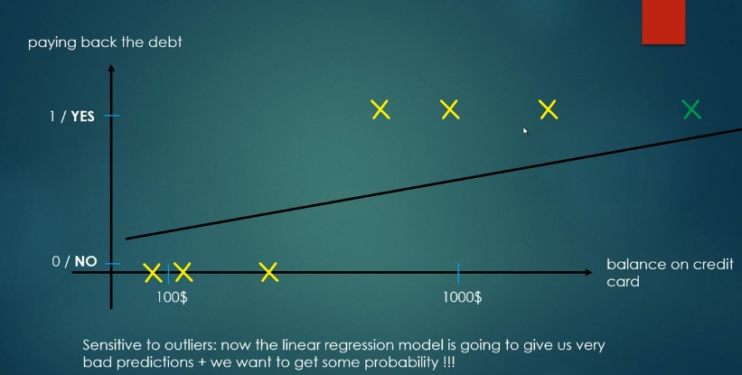
Linear Regression

Slide 4
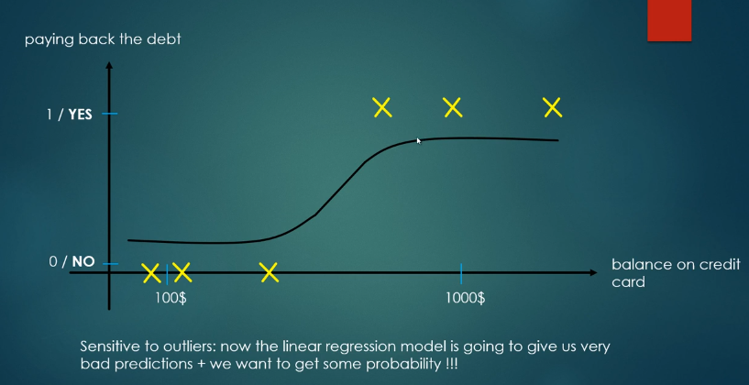
Logistic Regression

Slide 5
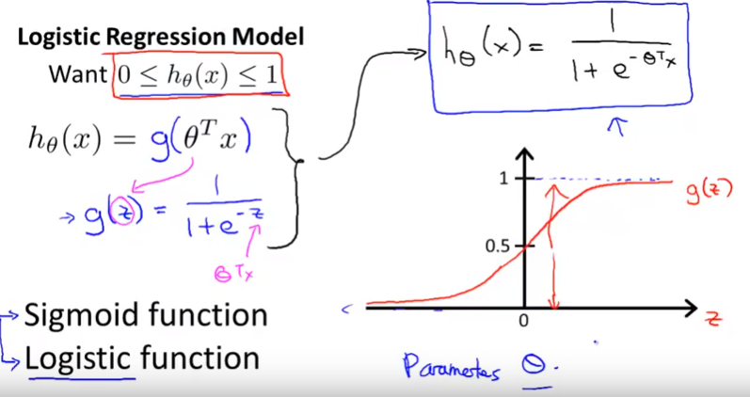

Slide 6
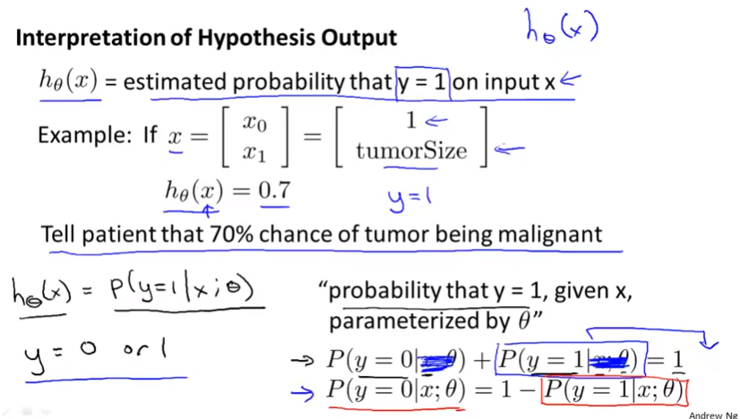

Slide 7
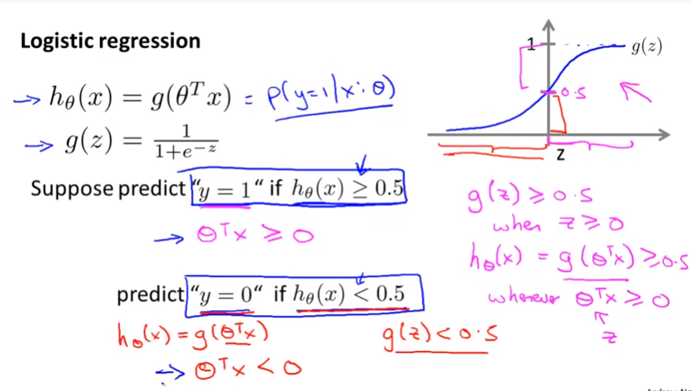

Slide 8
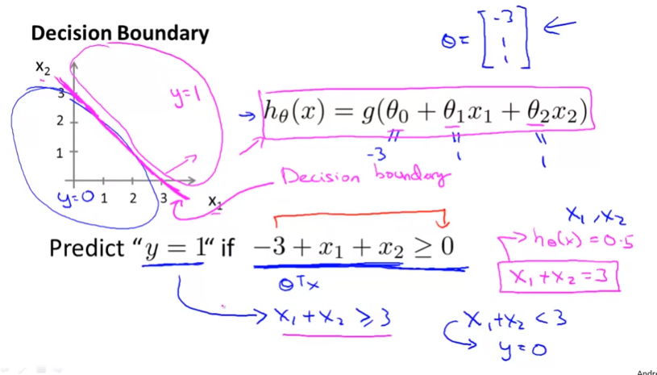

Slide 9
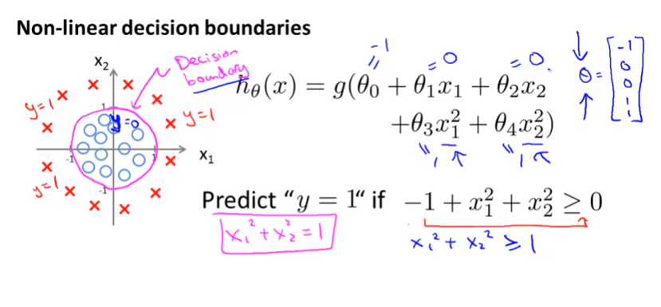

Slide 10
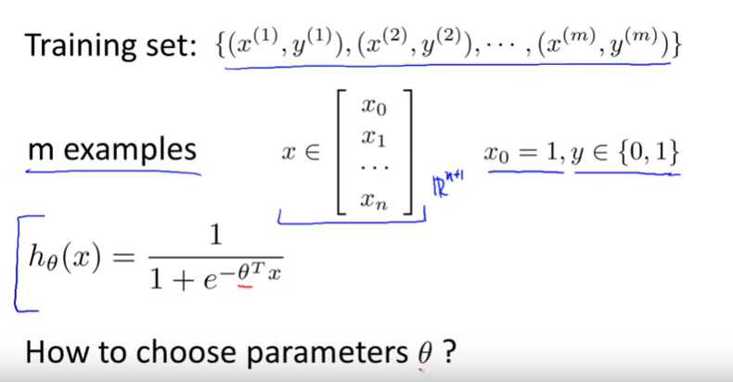
Cost Function

Slide 11
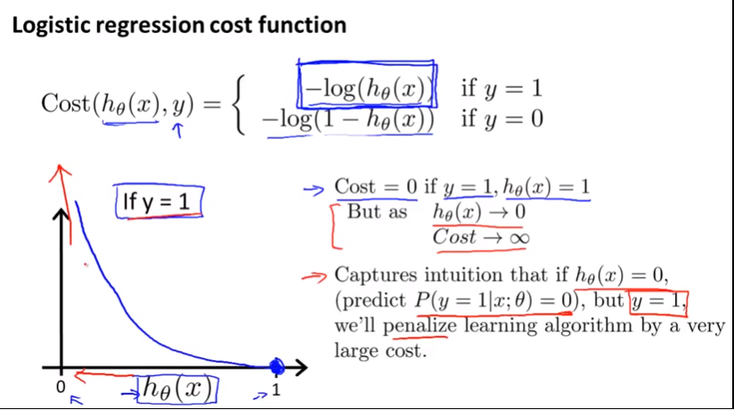

Slide 12
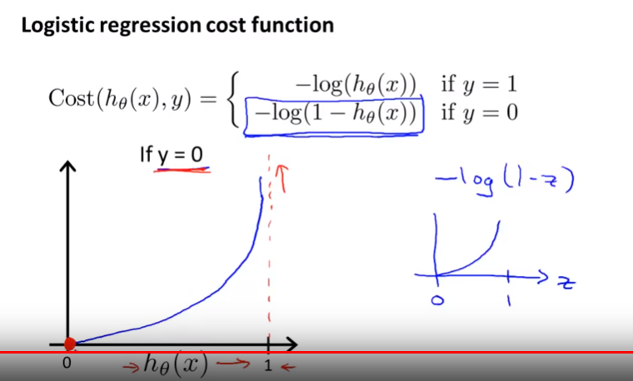

Slide 13
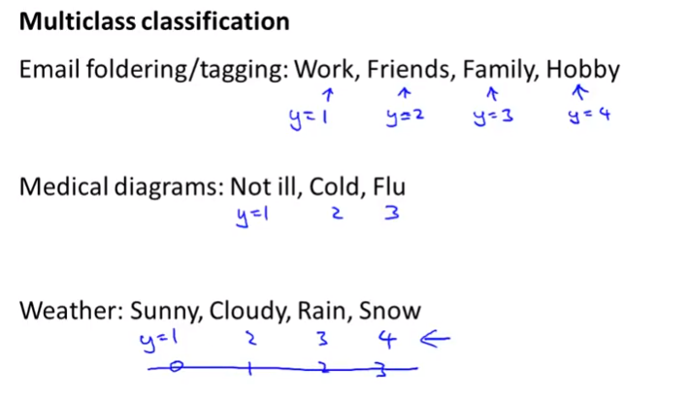
Multi-class classification

Slide 14
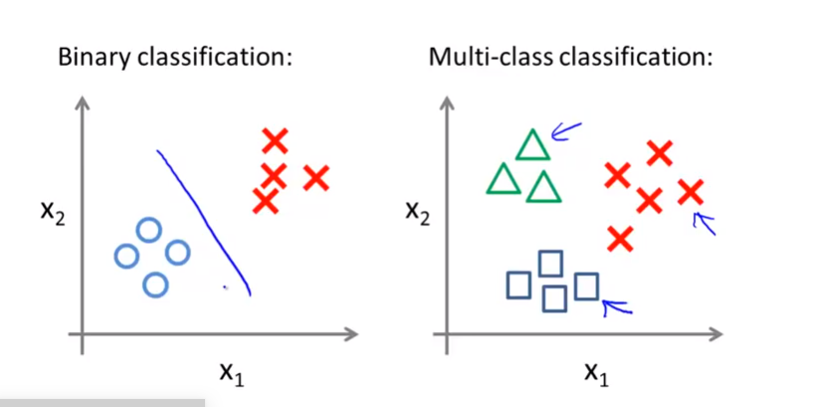
Multi-class classification

Slide 15
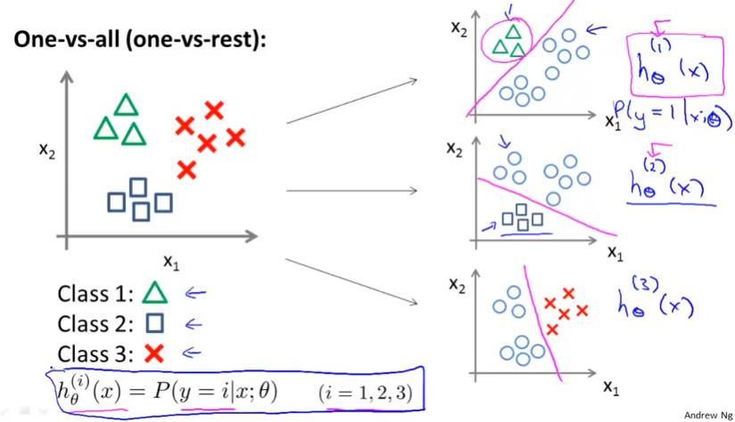
Multi-class classification

Slide 16
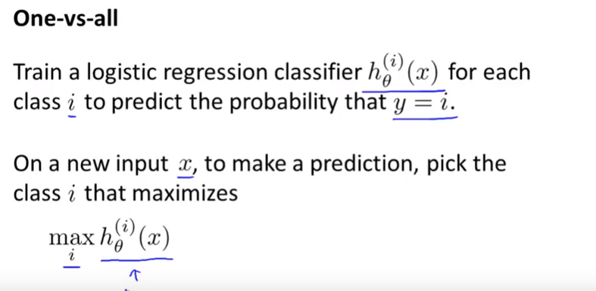

Slide 17
Reference
https://www.youtube.com/watch?v=PPLop4L2eGk&list=PLLssT5z_DsK-h9vYZkQkYNWcItqhlRJLN

